Slide 1
Cellular Automata Wars
Ionut Arhire
Coordonator: Drd. Florin Olariu
Notes:
Cellular Automata Wars is a browser-based game in which players compete using strategy and experience to win against opponents or train in singleplayer mode to attain knowledge and have some sandbox type of fun, meaning everything is possible.

Slide 2
Agenda
Contributions.
Used technologies.
What is a cellular automata?
Game of Life (most renowned CA).
Competitive CA.
Notation and CA comparison.
Demo.
Questions and Answers.

Slide 3
Contributions
Taking an ‘old’, abstract concept and making it into a ‘modern’ and fun looking one (gamification at its finest).
Supporting a whole community of CA enthusiasts (like myself).

Slide 4
Used technologies
Server-side
SignalR (coolest framework I’ve used)
.NET Core 2.1
Automapper
Sql Server
Client-side
Angular 6
RxJS
Material Design Bootstrap

Slide 5
What is a Cellular Automata?
Notes:
What is a Cellular Automata?
A cellular automaton consists of a regular grid of cells. The grid can be in any finite number of dimensions. For CA Wars however, the grid is 2-dimensional and so supports only 2-dimensional CAs.

Slide 6
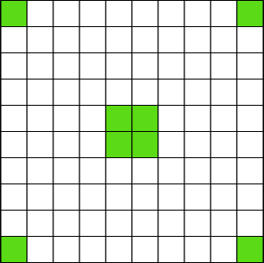

Slide 7
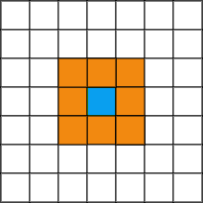

Slide 8
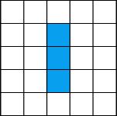
Game of Life transitions
Any live cell with fewer than two live neighbours dies, as if caused by underpopulation.
Any live cell with two or three live neighbours lives on to the next generation.
Any live cell with more than three live neighbours dies, as if by overpopulation.
Any dead cell with exactly three live neighbours becomes a live cell, as if by reproduction.

Slide 9
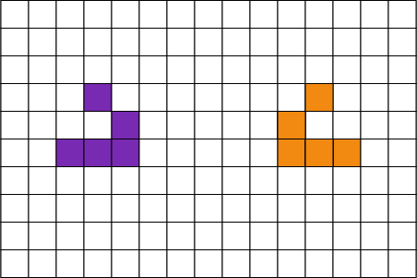
How do we deal with competitive evolution?

Slide 10
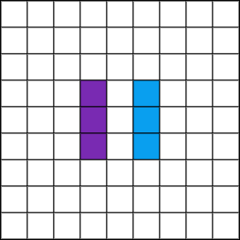
Basic conflict

Slide 11
The S/B Notation
(“Survival”/”Birth”)
Game of Life
23/3
Coral
45678/3

Slide 12
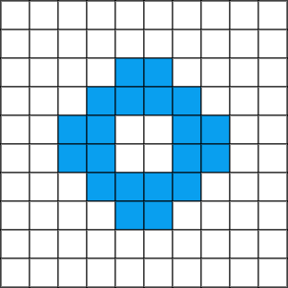
Let’s see how both rules evolve given the same initial configuration

Slide 13
Game of Life
(“Chaotic” Rule)
Coral
(“Explosive” Rule)
Notes:
Coral: This rule produces patterns with a surprisingly slow rate of expansion and an interesting coral-like texture.

Slide 14
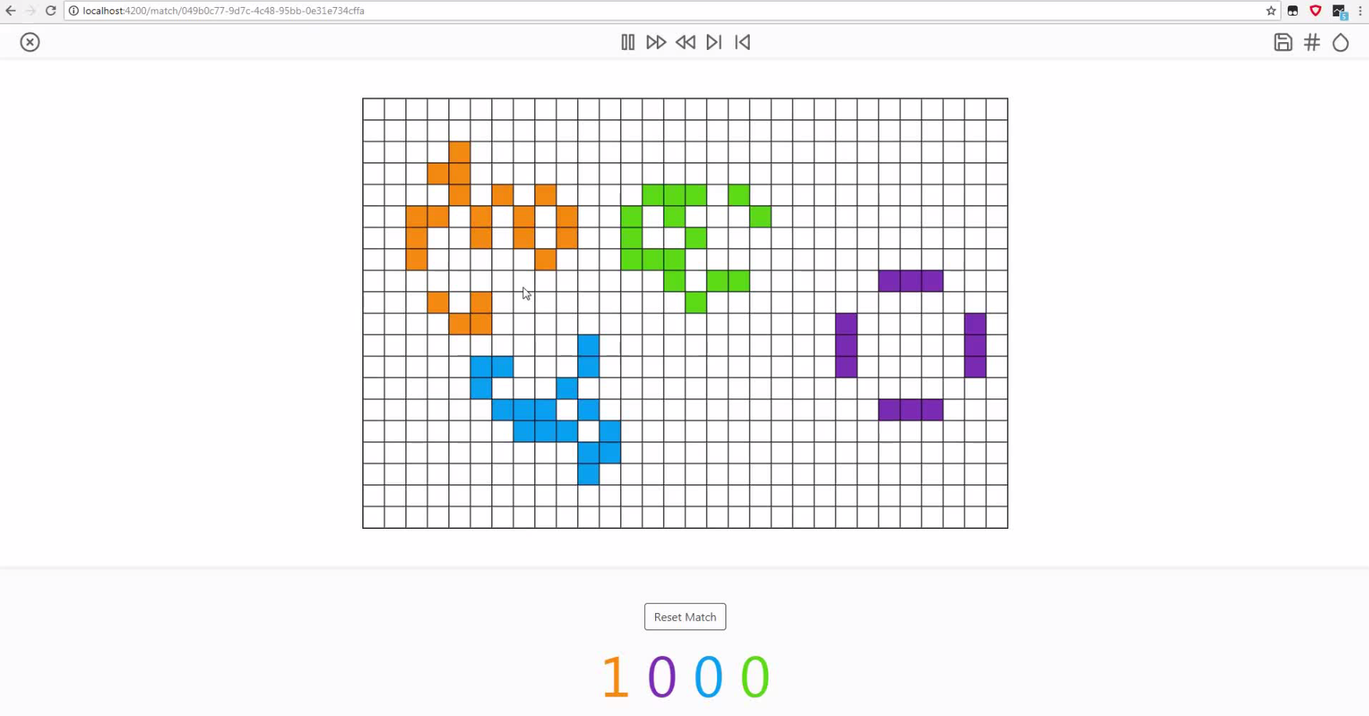
Demo

Slide 15
Questions and Answers

Slide 16
Thank You!

Slide 17
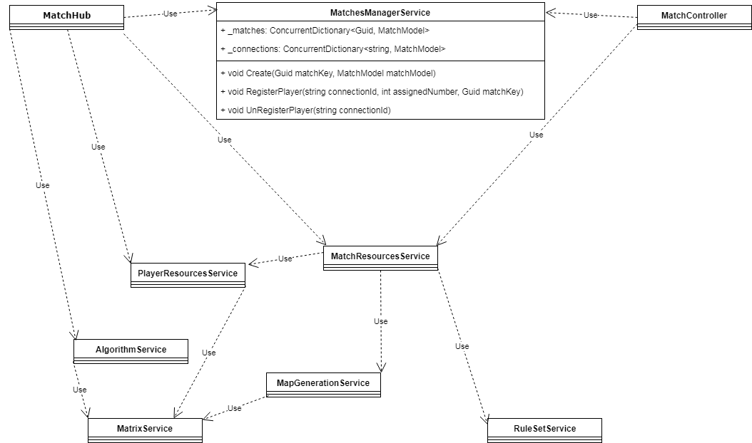
Server architecture

Slide 18
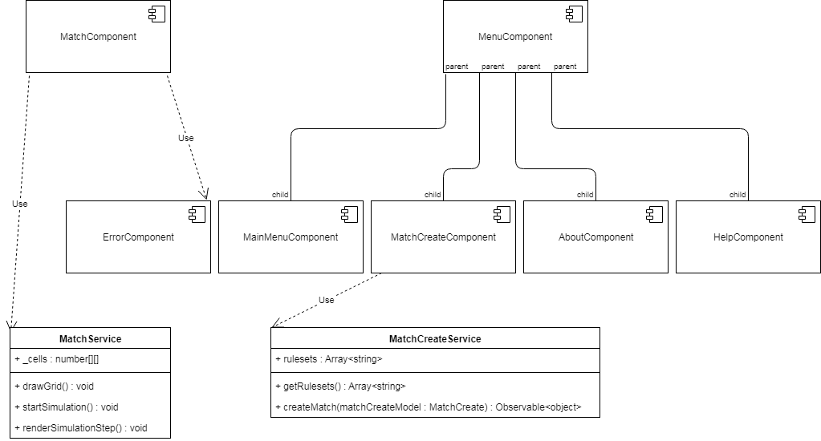
Client architecture

